Slide 1
Mgmt.101 Introduction to Business
Money, Finance, Wealth, & Investing

Slide 2
Money and Finance
Money
Any object which serves as a medium of exchange, a store of value, and a unit of account.
Anything that people generally accept as payment for goods and services.

Slide 3
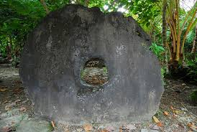
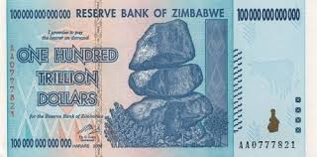
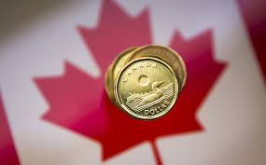
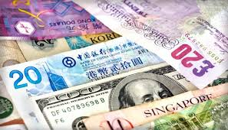

Slide 4
Characteristics of a Good Money System
Divisible
Portable
Durable
Hard to counterfeit
Stable in value

Slide 5
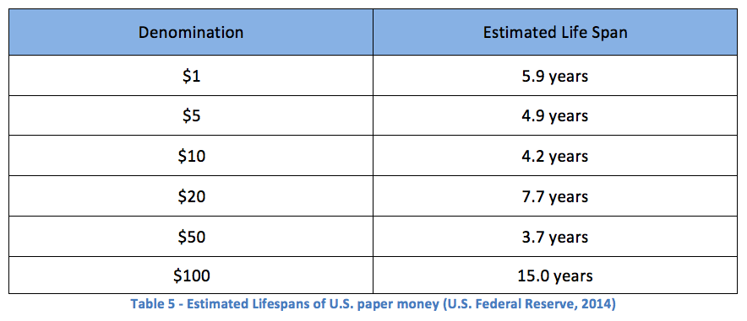
Lifespan of Money

Slide 6
Money and Finance
Finance The function in a business that acquires funds for the firm and manages funds within the firm.

Slide 7
Wealth
Generally, wealth is considered the accumulation of productive resources.
The ownership of the “means of production” to quote Karl Marx.
Productive resources generate income.

Slide 8
Wealth
What would you need to feel wealthy?
The question of how much people need to feel rich has been studied for ages, and just about every study comes to a similar conclusion: people need twice their current net worth or income to feel wealth.

Slide 9
Wealth
A Fidelity study gives us some broader details about today’s millionaires.
It found that 86 percent are self-made, as opposed to inheriting their fortunes.
The average age of today’s millionaire is 61. So all those Silicon Valley whiz kids, celebrities and athletes are outliers. The real rich are old.

Slide 10
Wealth
The top sources of wealth for the self-made millionaires are
investments and capital appreciation
compensation and employee stock options
or profit sharing

Slide 11
Why Consider Stocks?
When you buy common stock, you purchase a part of the company.
Returns come from:
Dividends - the company’s distribution of profits to stockholders.
Capital appreciation - the increase in the selling price of a share of stock.

Slide 12
Why Consider Stocks?
Neither dividends nor capital appreciation is guaranteed with common stock.
Dividends are paid at the board’s discretion.
Can be cash or additional stock.
Capital appreciation takes place when the company does well.

Slide 13
Why Consider Stocks?
Over time, common stocks outperform all other investments.
Stocks reduce risk through diversification.
Stocks are liquid.
Growth is determined by more than interest rates

Slide 14
The Federal Reserve System
Created in 1913.
The Federal Reserve is the central bank of the United States.
A central bank is the government agency that oversees the banking system and is responsible for the amount of money and credit in the economy.

Slide 15
The Fed’s Objectives
Stable prices
Maximum employment
Moderate long-term interest rates

Slide 16
The Federal Reserve System
The Fed. has four basic responsibilities:
Regulating commercial banks.
Performing bank-related activities for the U.S. Treasury.
Servicing member banks.
Setting monetary policy.

Slide 17
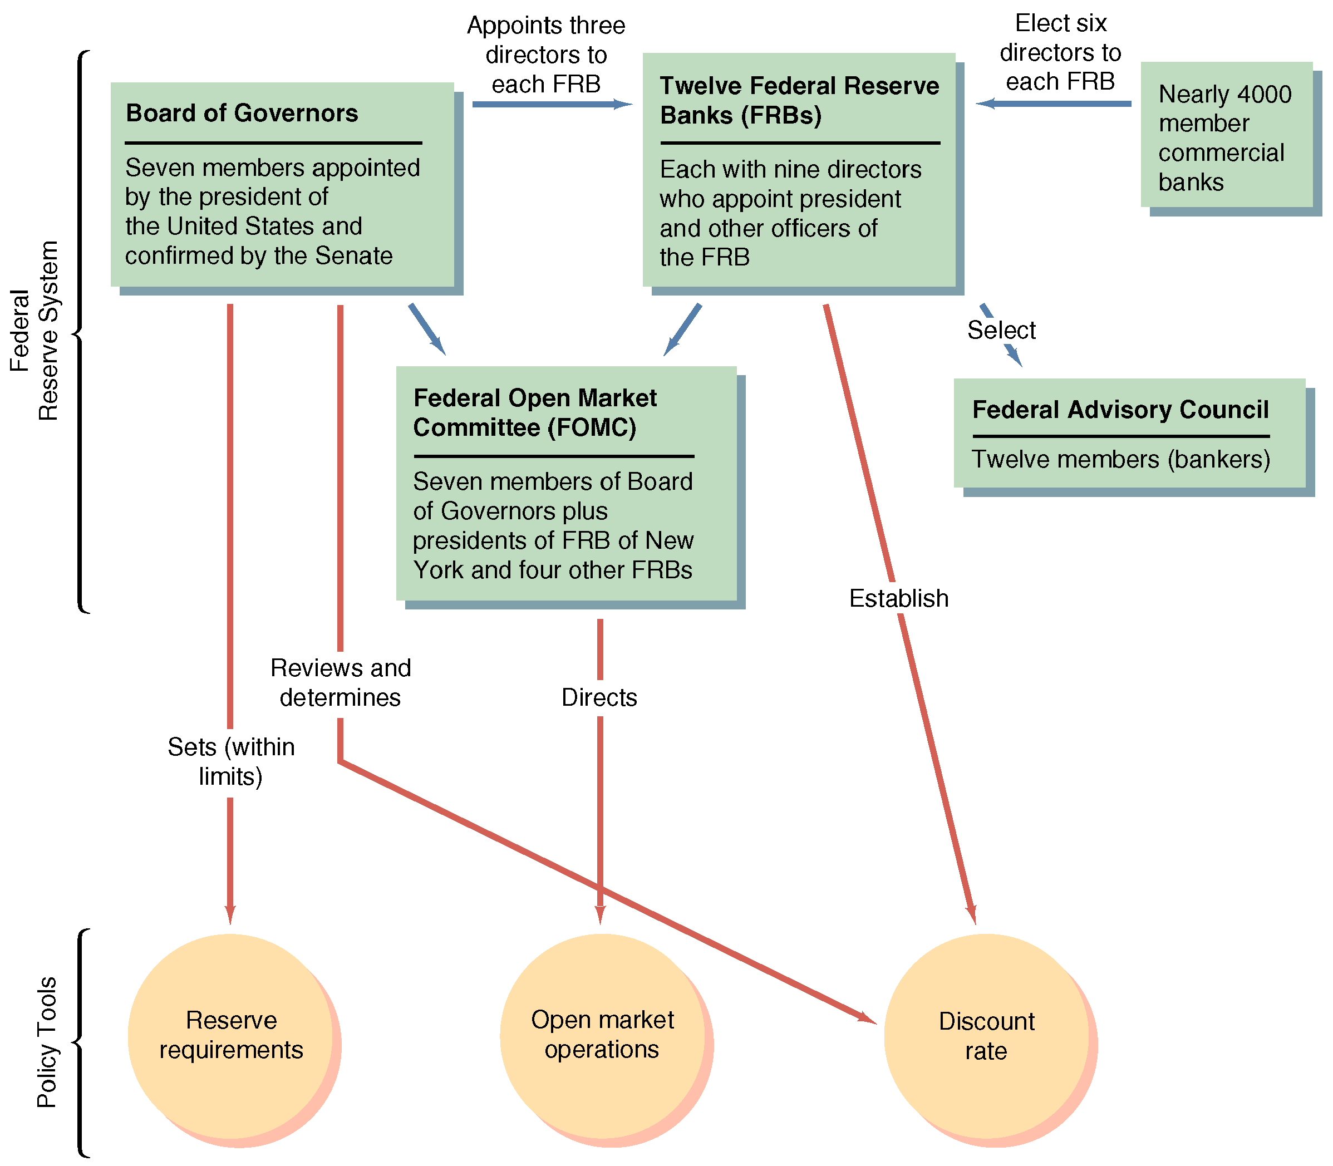

Slide 18
The Federal Reserve Board of Governors
Comprises 7 appointed members.
Sets reserve requirements and approves the discount rate as part of monetary policy.
Supervises and regulates member banks and bank holding companies.
Establishes and administers protective regulations in consumer finance.
Oversees the Federal Reserve banks.

Slide 19
Federal Reserve Banks
There are 12 banks in the Federal Reserve System.
They propose discount rates.
They hold deposits (reserve balances) from banks in their area.
They set discount rates for those banks.
They furnish currency.
They clear checks.
They handle U.S. government debt and cash balances.

Slide 20
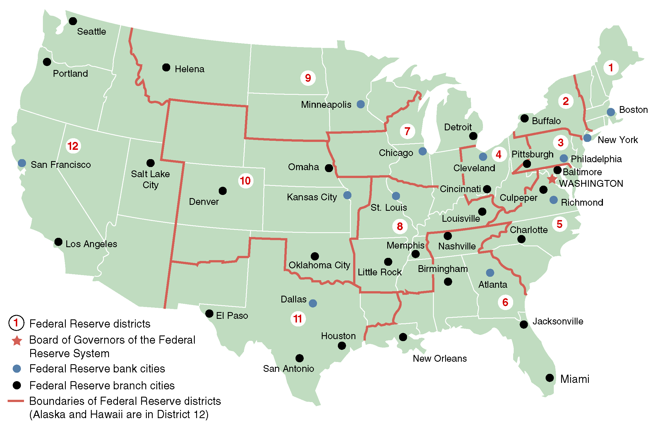

Slide 21
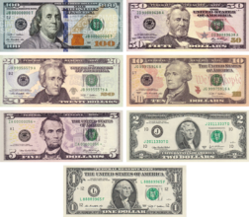

Slide 22
Interest Rates
The Discount Rate is one of the interest rates controlled by the Fed. It is the rate at which the 12 Federal District Banks lend directly to financial institutions.
The Federal Funds Rate is the interest rate at which banks lend to each other.
The Prime Rate is the interest rate charged by banks to their most credit-worthy customers – usually the most prominent and stable business customers.

Slide 23
The Federal Open Market Committee (FOMC)
The policy making body of the Fed.
Comprises the 7 members of the Board of Governors plus 5 Federal Reserve Bank presidents.
Directs open market operations (the buying and selling of U.S. government securities) which are the primary instrument of monetary policy.

Slide 24
BONDS
Bonds are securities (secured by the value of assets) through which an issuer promises to pay the buyer a certain amount of money by a specified future date, usually with interest paid at regular intervals.
In effect, they are IOUs.
Bonds differ in terms of maturity dates, tax status, and level of risk versus potential yield.

Slide 25
Bond Ratings
To aid bond investors in their purchasing decisions, several services/companies rate the quality of bonds.
Moody's, Standard and Poor's, etc. rate bonds on a letter system -- Aaa or AAA is safest, C or D is riskiest.
Ratings measure default risk – the chance that one or more promised payments will be deferred or missed altogether.

Slide 26
JUNK BONDS
A bond that is rated below investment grade.
Have a higher risk of default.
Typically offer higher yields in order to make them attractive to investors.
AKA non-investment-grade bond or speculative-grade bond.

Slide 27
Time Value of Money
The expectation that money will increase in value over time.
The process by which, money today, a present value, grows over time to a larger amount, a future value, is called “Compounding”.

Slide 28
Interest
Simple Interest
Normally paid annually
Earned on deposited capital only
For example: $1,000 at 8% interest.
You would receive $80 at the end of the first year and another $80 at the end of the second year.

Slide 29
Interest
Compound Interest
Interest earned on an investment is added back to the amount invested
This increasing the amount of 'principal' on which further interest will be earned
For example: $1,000 at 8% interest.
The $80 interest earned on the first year would be added to the original capital, and the amount of money earning interest in the second year would be $1,080.00

Slide 30
The Inflation Effect
Inflation is a rise in the values of commodities over time.
It causes the real value of money to fall.
At 6% inflation, $100 will be worth only $31, in 20 years – You will be able to buy less with the same amount.
Investment should be able to provide a return above inflation rate to ensure increased value of money. (Real rate of return)

Slide 31
The Primary Stock Market
The Primary Market is where investors purchase newly issued securities.
Is the part of the capital markets that deals with the issuance of new securities.
Initial public offerings (IPOs) occur when a company offers stock for sale to the public for the first time.

Slide 32
The Primary Stock Market
IPOs are typically done through a syndicate of securities dealers.
Companies, governments or public sector institutions can obtain funding through the sale of a new stock or bond issue.

Slide 33
An IPO Involves Several Steps
Company appoints investment banking firm to arrange financing.
Investment banker designs the stock issue and arranges for fixed commitment or best effort underwriting.
Company prepares a prospectus (usually with outside help) and submits it to the Securities and Exchange Commission (SEC) for approval. Investment banker circulates preliminary prospectus (red herring).

Slide 34
An IPO Involves Several Steps
Upon obtaining SEC approval, company finalizes prospectus.
Underwriters place announcements (tombstones) in newspapers and begin selling shares.

Slide 35
The Secondary Stock Market
The Secondary Market is where investors trade previously issued securities.
An investor can trade through a broker who arranges transactions for others.

Slide 36
The Secondary Market for Common Stock
The bid price:
The price dealers pay investors.
The price investors receive from dealers
The ask price:
The price dealers receive from investors.
The price investors pay dealers.
The difference between the bid and ask prices is called the bid-ask spread, or simply spread.

Slide 37
The Secondary Market for Common Stock
Most common stock trading is directed through an organized stock exchange or trading network.
The goal is to match investors wishing to buy stocks with investors wishing to sell stocks.

Slide 38
Stock Markets & Exchanges
Locations for trading
Trading is done by members who own a seat on the exchange
Stock traded on exchange are listed stocks - securities that have been accepted for trading

Slide 39
The New York Stock Exchange
The New York Stock Exchange (NYSE), popularly known as the Big Board, began in May, 1792.
Has occupied its current building on Wall Street since the turn of the 20th century
Is a not-for-profit New York State corporation.

Slide 40
NYSE Membership
Has 1,366 (fixed) exchange members who own “seats” on the exchange.
They collectively own the exchange, although it is managed by a professional staff.

Slide 41
NYSE Membership
Seats are regularly bought and sold.
Seats sell for as high as $4 million.
Seats can be leased.
Both prospective buyers and leaseholders are closely scrutinized.
Seat holders can buy and sell securities on the exchange floor without paying commissions.

Slide 42
Types of NYSE Members
Over 500 NYSE members are commission brokers who execute customer orders to buy and sell stocks.
Almost 500 NYSE members are specialists, or market makers.
Market makers are obligated to maintain a “fair and orderly market” for the securities assigned to them.

Slide 43
Types of NYSE Members
When commission brokers are too busy, they may delegate some orders to floor brokers, or two-dollar brokers, for execution.
Floor brokers have become less important because of the efficient SuperDOT system (designated order turnaround),
SuperDOT allows orders to be transmitted electronically directly to the specialist.
A small number of NYSE members are floor traders, who independently trade for their own accounts.

Slide 44
Operation of the New York Stock Exchange
The fundamental business of the NYSE is to attract and process order flow.
The number of shares traded every day generally between 1.5 billion and 2.3 billion.
Volume breakdown:
About one-third from individual investors
Almost half from institutional investors.
The remainder represents NYSE-member trading, mostly from specialists acting as market makers.

Slide 45
NYSE Floor Activity
There are a number of specialist’s posts, each with a roughly figure-eight shape, on the floor of the exchange.
At the telephone booths, commission brokers:
Receive customer orders
Walk out to specialist’s posts where the orders can be executed,
Return to confirm order executions, and receive new customer orders.
Coat colors indicate the person’s job or position.

Slide 46
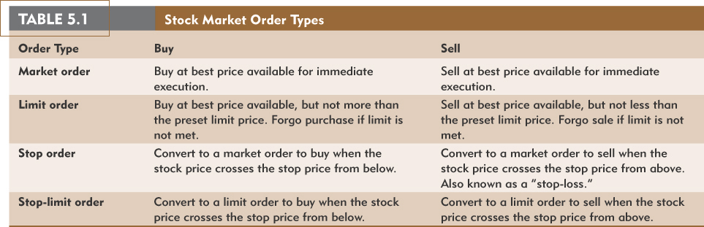
Stock Market Order Types

Slide 47
Order Size
Round lots
lots of 100 shares
Odd lots
less than 100 shares
more difficult to trade
Block trades
10,000 shares or $200,000 value

Slide 48
Buying on Margin
Buyer borrows part of purchase price of stock, using stock as collateral
borrow at call money rate
Fed sets initial margin requirement
minimum cash payment
50% since 1975

Slide 49
Buying on Margin
If stock price falls
collateral worth less
if collateral worth only 125% of loan (maintenance margin)
-- margin call
-- owner must put up more cash or sell stock
Margin calls can worsen stock crash

Slide 50
NASDAQ
National Association of Securities Dealers Automated Quotations system.
Introduced in 1971, NASDAQ is a computer network of securities dealers who distribute timely security price quotes to subscribers.

Slide 51
NASDAQ
The second largest stock market in the U.S. in terms of total dollar volume of trading.
As of January 25, 2011, there are 2,711 listings, with a total capitalization of over $4.5 trillion.

Slide 52
NASDAQ
Often referred to as an Over-the-counter (OTC) market.
Trading is almost exclusively done through dealers who buy and sell for their own inventories.

Slide 53
NASDAQ
There are two key differences between the NYSE and NASDAQ:
NASDAQ is a computer network and has no one physical location where trading takes place.
NASDAQ has a multiple market maker system rather than a specialist system.

Slide 54
Regional Exchanges
5 regional exchanges
Cheaper seat prices
Stocks may be listed on both NYSE and regional exchange

Slide 55
Market Movements
A bear market is characterized by falling prices.
A bull market has rising prices.

Slide 56
Market Movements
A market crash is when a market (or group of markets such as the stock indices) makes a larger than normal, and quicker than normal move downwards, as a result of uncontrolled selling (or panic selling).

Slide 57
Market Movements
It is commonly believed that any significant move downwards is a crash, but this is incorrect.
The uncontrolled selling must be present in order for the move downwards to be a market crash.

Slide 58
Market Movements
Market Corrections take place in the midst of a bull market (a long-term uptrend in the market). There is no hard and fast definition of the term "market correction", but most agree that it usually a 15-20% (max) drop in the markets in the midst of an overall uptrend.

Slide 59
Stock Market Indicators
Measure average performance of a group of stocks
Different indexes are highly correlated and comparable
DJIA
S&P 500
NYSE

Slide 60
Stock Market Indexes
Indexes can be distinguished in four ways:
The market covered,
The types of stocks included,
How many stocks are included, and
How the index is calculated (price-weighted, e.g. DJIA, versus value-weighted, e.g. S&P 500)

Slide 61
Stock Market Indicators
The most widely followed index of day-to-day stock market activity is the Dow Jones Industrial Average (DJIA), or “Dow” for short.
Created by Charles Dow in 1896 to gauge the well-being of the market, was based on 12 companies.
Trend analysis.

Slide 62
Stock Market Indicators
Increased to 30 stocks in 1928.
They are large companies representative of American industry. with GE the only original Dow component.
Best-known, oldest, most popular index.

Slide 63
The Wall Street Journal
The WSJ is an international daily newspaper with a special emphasis on business topics and economic and financial news and issues.
It is published in New York City by Dow Jones & Company.

Slide 64
Dow Jones History
Dow Jones & Company was founded in 1874 by
Charles Henry Dow,
Edward Jones, and
Charles Bergstresser

Slide 65
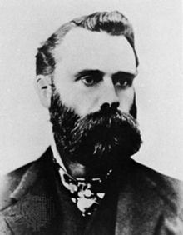
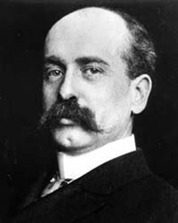
Dow Jones History
Charles Henry Dow
Edward Jones

Slide 66
Dow Jones History
Over two decades they created three products which define Dow Jones and financial journalism:
The Wall Street Journal,
Dow Jones Newswires and the
Dow Jones Industrial Average (DJIA).

Slide 67
Dow Jones History
The founders stated their commitment to excellence in the Journal’s first issue: “We appreciate the confidence reposed in our work. We mean to make it better.”

Slide 68
Dow Jones History
1882: Dow, Jones & Company’s first product is brief news bulletins hand-delivered throughout the day to traders at the stock exchange. Those "flimsies" as they are called later are aggregated in a printed daily summary called the "Customer's Afternoon Letter."
1889: The first edition of The Wall Street Journal is published July 8. An afternoon newspaper, it covers four pages and sells for two cents.
1896: The Dow Jones Industrial Average is officially launched.

Slide 69
Dow Jones History
1897: The Ticker, the real-time newswire and the fundamental source for news in the investment community, is announced.
1898: The Journal, now six pages, adds a morning edition.
1899: The Journal's "Review & Outlook" column, which still runs in the Journal today, appears for the first time. It initially was written by Charles Dow.

Slide 70
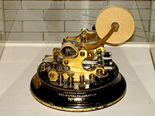
Stock Symbol Or Ticker Symbol
A stock symbol or ticker symbol is a short abbreviation used to uniquely identify publicly traded shares of a particular stock on a particular stock market.
A stock symbol may consist of letters, numbers or a combination of both.
"Ticker symbol" refers to the symbols that were printed out on the ticker tape machine.
Stock telegraph ticker machine by Thomas Edison

Slide 71
DJIA
The Dow Jones Industrial Average (DJIA) also called the Industrial Average, the Dow Jones, the Dow 30, or simply the Dow, is a stock market index, and one of several indices created Charles Dow.

Slide 72
DJIA
It originally represented the dollar average of 12 stocks from leading American industries.
In 1928, the components of the Dow were increased to 30 stocks.
It is a method of statistically sampling the value of the stock market and, by extension, the strength of the economy.

Slide 73
DJIA
Along with the NASDAQ Composite, the S&P 500 Index, and the Russell 2000 Index, the Dow is among the most closely watched U.S. benchmark indices tracking targeted stock market activity.

Slide 74
DJIA
Although Dow compiled the index to gauge the performance of the industrial sector within the American economy, the index's performance continues to be influenced by not only corporate and economic reports, but also by domestic and foreign political events such as war and terrorism, as well as by natural disasters that could potentially lead to economic harm.

Slide 75
Stock Market Crashes
Panic of 1901
May 17, 1901
3 year recovery period
The market was spooked by the assassination of President McKinley in 1901, coupled with a severe drought later the same year.

Slide 76
Stock Market Crashes
Panic of 1907
October
1 year to recover
Markets took fright after U.S. President Theodore Roosevelt threatened to rein in the monopolies that flourished in various industrial sectors, notably railways.

Slide 77
Stock Market Crashes
Wall Street Crash of 1929
Also called the Great Crash or the Wall Street Crash, leading to the Great Depression.
Black Thursday - October 24, 1929
Black Monday - October 28, 1929
Black Tuesday - October 29, 1929
4 years to recover

Slide 78
Crash of 1929
The bursting of the speculative bubble in shares led to further selling as people who had borrowed money to buy shares had to cash them in, when their loans were called in.

Slide 79
Stock Market Crashes
Recession of 1937–1938
Mid-1937 to mid-1938
This share price fall was triggered by an economic recession within the Great Depression and doubts about the effectiveness of Franklin D. Roosevelt's New Deal policy.

Slide 80
Stock Market Crashes
Black Monday
Monday October 19, 1987
stock markets around the world crashed
The explanation for the 1987 crash was selling by program traders.

Slide 81
Stock Market Crashes
Program trading is a type of trading in securities, which is executed by a computer program based on predetermined conditions.
Once these programs went into “sell mode”, there was no stopping them.
Subsequently, “circuit breakers” were programed in to prevent this type of crash happening again.

Slide 82
Wall Street Crash of 2001
Triggered by the 9/11 attack on the United States.
Main U.S. markets were closed after the attacks, which occurred just as the trading day was about to begin.

Slide 83
Wall Street Crash of 2001
Investors across the world snapped up traditional safe assets like gold and bonds after the attack pummeled global stocks, shook the U.S. dollar and drove up oil prices.
After a delayed opening, Tokyo stocks slid to 17-year lows, with the Nikkei stock average losing 6.23 percent to 9,651.62 and breaching 10,000 for the first time since August 1984.

Slide 84
Wall Street Crash of 2007
On February 27, the Dow index fell 3.3 percent, or 416 points, following a collapse in Chinese stocks and weak U.S. manufacturing data.
Chinese stocks plunged nearly 9 percent, erasing about $140 billion of value in their biggest fall for a decade.

